Slide 1







Group 4 – BUS 5100-93
Christian Gutierrez
Diandra Ortiz
Jason Gaskin
J.P Puga
Owais Shaikh
Quang Pho

Slide 2
Restaurant & Market Health Code Violation & Inspection Patterns in Los Angeles

Slide 3
Objective
Utilize the data set for a restaurant and market health violation provided by the county of Los Angles and create story illustrations and predictive analysis via SAP.

Slide 4

Introduction
Agency: Los Angeles Sanitation and Environment (LASAN) is a local government agency.
Mission: To protect public heath and the environment through providing an array of services to over 4 million Angelenos.
Program: One of LASAN’s program is FOG to reduce the discharge of fat, oils and grease into the sewer system.
Consequence : Failing to properly maintain the system pose significant health and safety threats (sewage overflow, sinkholes etc.)
Information Management: The city primarily uses PIMS and SCADA to access data base which is used for inspection history, facility info, running queries, as well as generating reports and notices of violations.

Slide 5
Related Work
Data Base Review: An analysis was conducted by exploring the correlation between the frequency of inspections compared to the overall violation scoring.
Study Performed: The article A Study of Food Service Establishment Sanitation Inspection Frequency spotlighted a 1972 study conducted in Seattle’s Central Health District by local sanitarians.
Objective of Study: To evaluate the necessity of quarterly onsite inspection visits.
Conclusion:
Quarterly inspections were important to maintain high food quality compared to the results of infrequent inspections which resulted in the significant decline of food quality standards.
The primary difference between the article reviewed and the group analysis of the dataset is the article research thoroughly considered separate subsets to reach their conclusion.

Slide 6
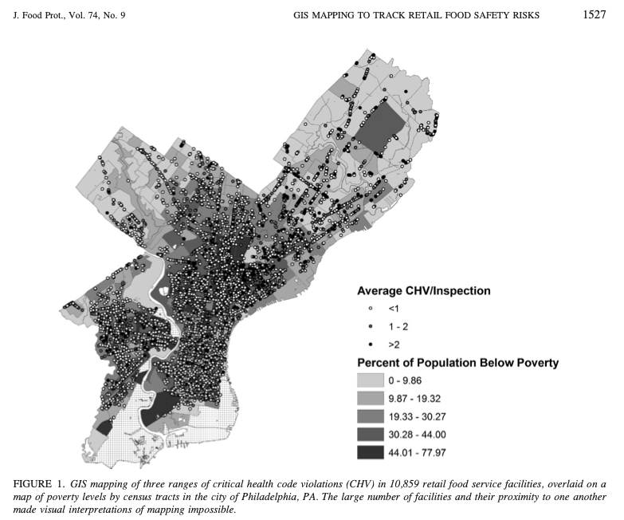
Existing Work
STUDY #1: “Use of Geographic Information Systems Technology To Track Critical Health Code Violations in Retail Facilities Available to Populations of Different Socioeconomic Status & Demographics”
Data: Food inspection data in Philadelphia from 2005 to 2008 acquired from the U.S. Census Bureau
Purpose: Indicates the relationship between the ­risk of foodborne illness & social status.
Method: Based on critical health code violations (CHV) of restaurants, Geographic Information Systems (GIS) is used to navigate areas of healthy food on Philadelphia’s map
Demographic analysis: Higher number of food facilities in areas with high poverty rates.
Food facilities in low-income areas got inspected more frequently
Poor areas had a higher number of CHV per inspection → more safety risk
African American & Hispanic had higher violation rates than other demographics
Compare to our study:
Our dataset is structured similarly: points, grade, latitudes & longitudes.
We use GeoMap to illustrate where have more violations & points
However, we have fewer demographic data.

Slide 7
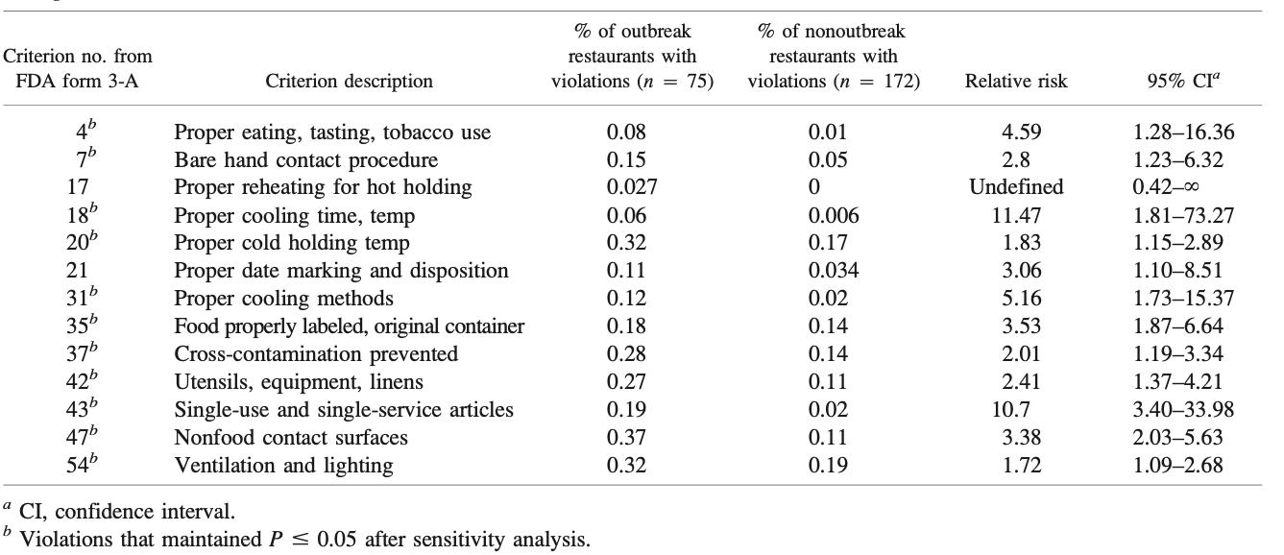
Existing Work
STUDY #2: “Health Department Inspection Criteria More Likely To Be Associated with Outbreak Restaurants in Minnesota”
Reason: Was created after a dangerous Salmonella outbreak in Minnesota took place in 2009
Purpose: to investigate the cause of the outbreak & to understand the relationship food facilities’ inspection vs. risk of foodborne illness (Salmonella, Perfringens)
Method: Based on the most common violation code associated with contamination and incorrect food handling procedures to investigate outbreak restaurants.
Compare to our study:
We also use points per violation to identify the top 10 violation codes in the City of Los Angeles.
However, our work is different from this study we focus on
Forecasting models
Interactive visualizations (map, charts)

Slide 8

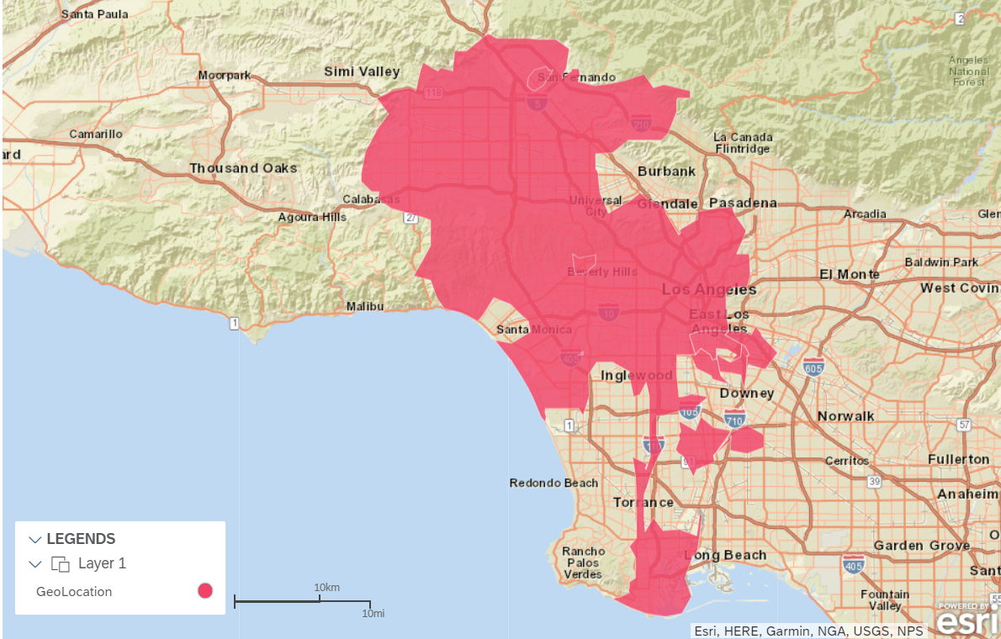
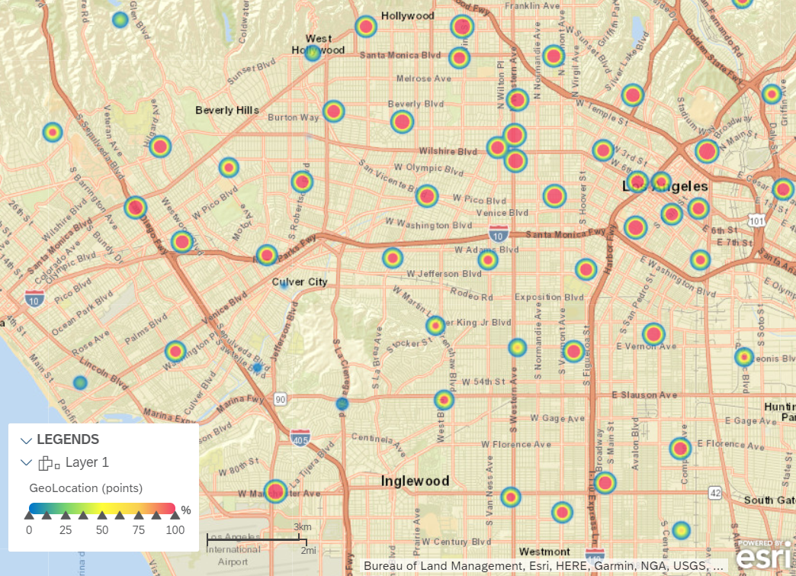
Our Work – Geo Maps
The map shows the general location of restaurants that were within the scope of our study.
The map clearly shows the exact location of businesses with number of violations.

Slide 9
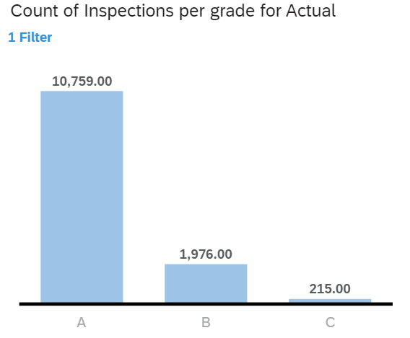
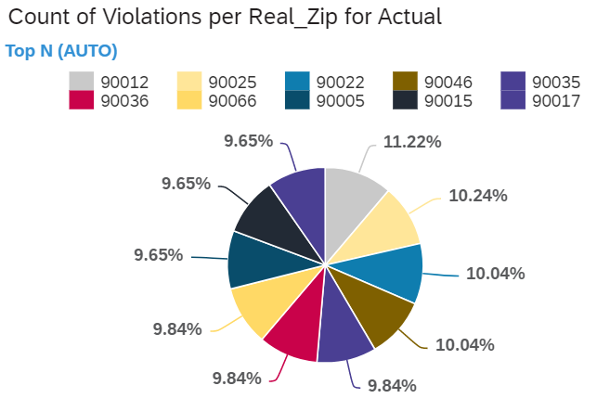
Our Work – Violations by Zip Code
Counts of Inspections per grade
Grade A businesses are inspected much more often.
Count of Violations per Zip code
Zip code 90017 has the least violations and Zip code 90012 has the most violations reported.

Slide 10
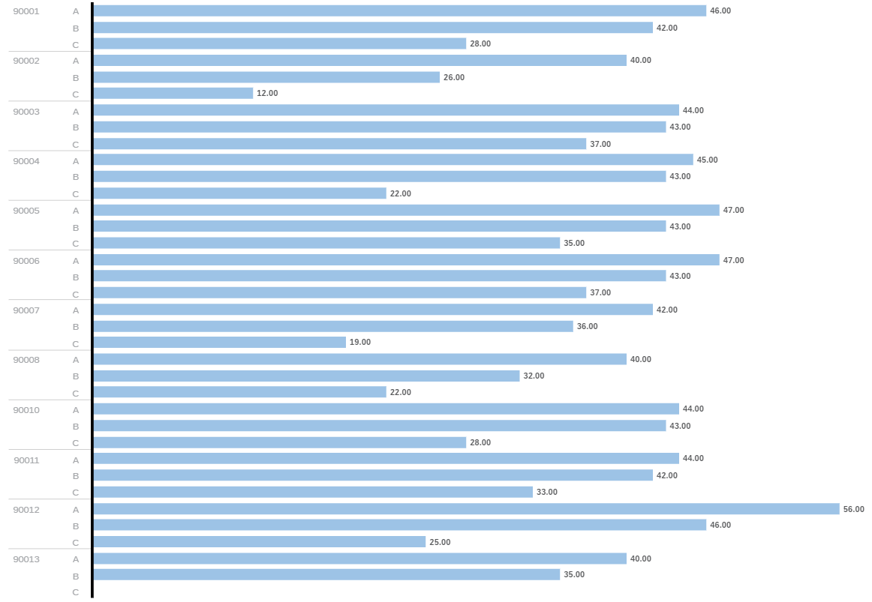
Our Work – Violations by Zip Code
Letter Grades per Zip Code.
Zip code 90012 has the highest number of business with a letter grade A.

Slide 11
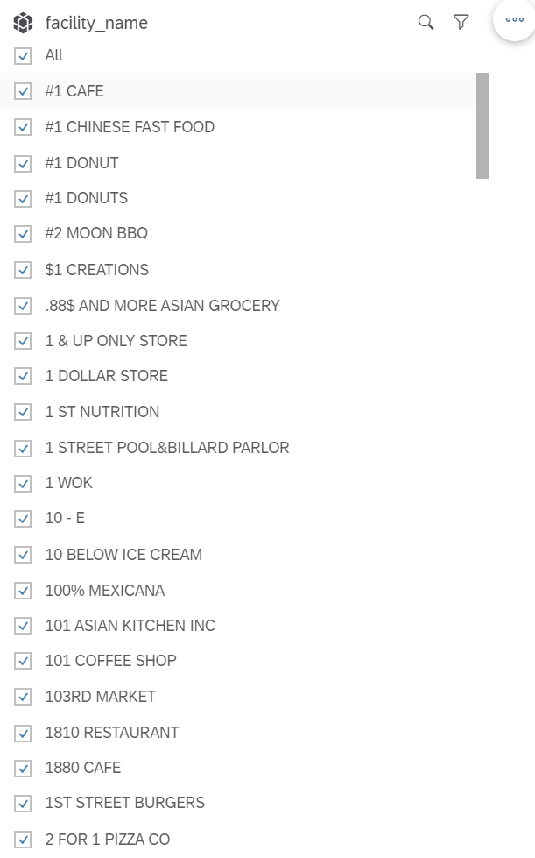
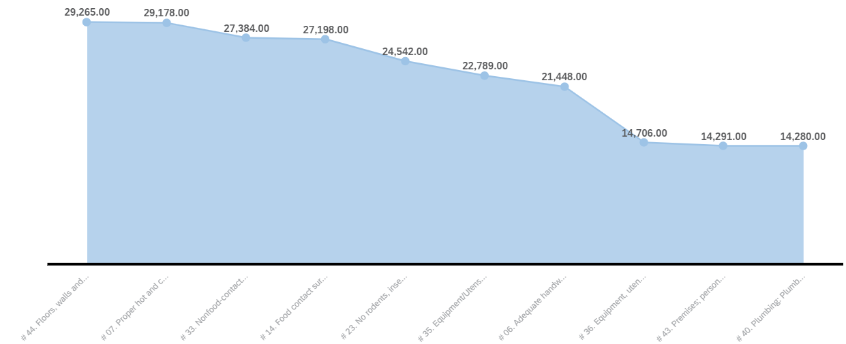
Our Work – Violation per Facility
Top 10 violations per facility.
This can be filtered by type of facility and type of violation.

Slide 12
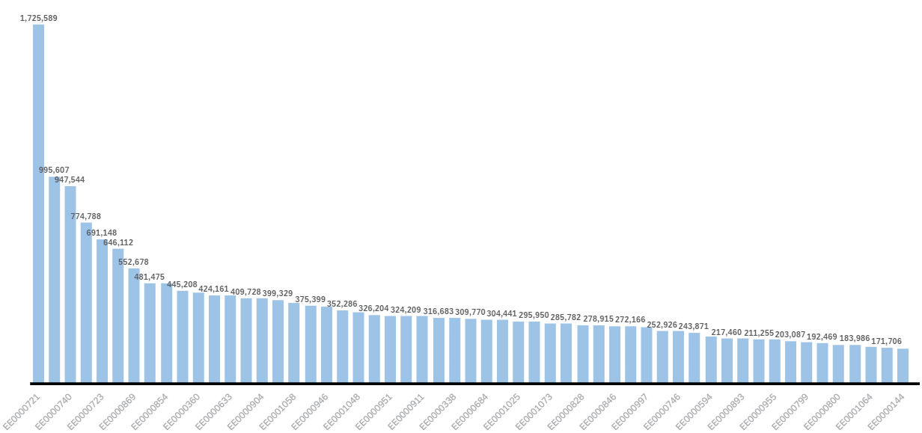
Our Work – Score by Inspector
Employee’s score count displays the overall scores given by each employee.
Employee EE0000721 has given vastly higher scores to restaurants in the data set.

Slide 13
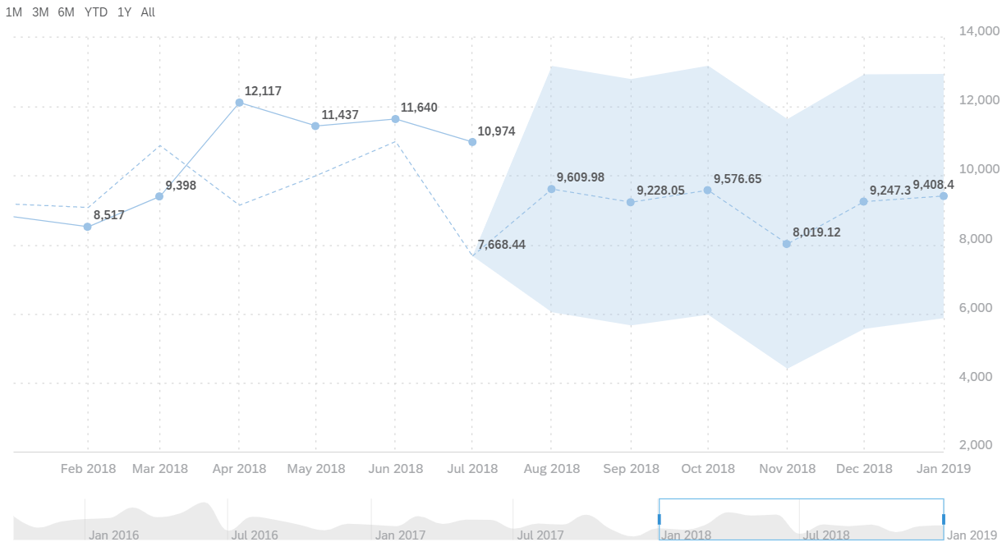
Our Work – Forecasting
Most occurring violation in the entire data set is relating to the floors, walls, and ceilings not being in good repair or clean.
The second most commonly occurring violation is the restaurant not keeping the holding conditions of the food at the appropriate temperature.

Slide 14
Conclusion
Certain zip codes have a higher number of violations.
Certain businesses are inspected much more often.
Most inspections have a similar score measured by points per violation.
Some inspectors give 2-3 times as many points more than the average.

Slide 15
Data Source & References
Date Source: https://drive.google.com/file/d/1DaPlkcAIjMDbC8DMkxeyZCSGux1nYOYc/view?usp=sharing
Date Size: 98MB
SAC: https://higher-education.us10.sapanalytics.cloud/sap/fpa/ui/tenants/81639/bo/story/5B02CB07E26C6A41D584AC71949DADD9
Existing Work: Darcey, V. L., & Quinlan, J. J. (2011). Use of geographic information systems technology to track critical health code violations in retail facilities available to populations of different socioeconomic status and demographics. Journal of food protection, 74(9), 1524-1530.
Existing Work: Petran, R. L., White, B. W., & Hedberg, C. W. (2012). Health department inspection criteria more likely to be associated with outbreak restaurants in Minnesota. Journal of food protection, 75(11), 2007-2015.
Related Work: Bader, M., Blonder, E., Henriksen, J. E. A., & Strong, W. (1978). A study of food service establishment sanitation inspection frequency. American Journal of Public Health, 68(4), 408-410.

Slide 16

Thank You!

